Slide 1

A
Presentation on
Swapping of two numbers
Presented by- Anupam nath
Course - SQA (manual testing)

Slide 2

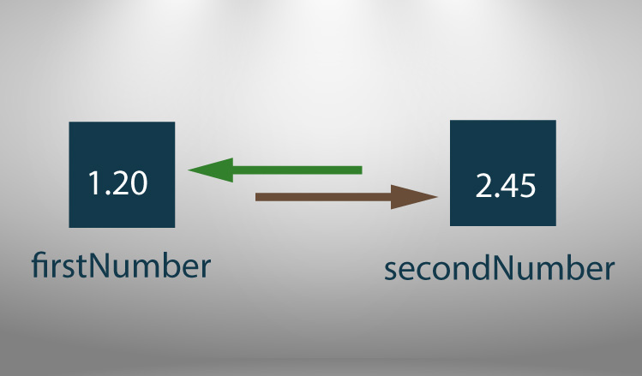


What is swapping of two numbers?

Slide 3
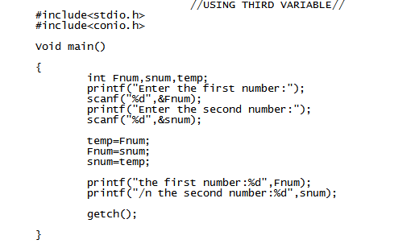
Program code in c
for swapping two numbers
With using Third variable

Slide 4
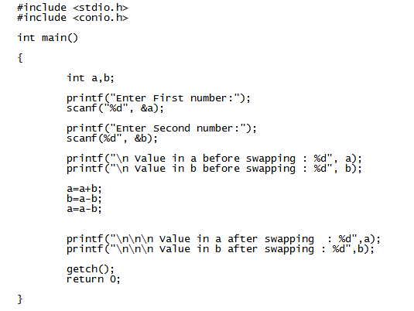
Without using Third variable

Slide 5


Slide 6


